Slide 1
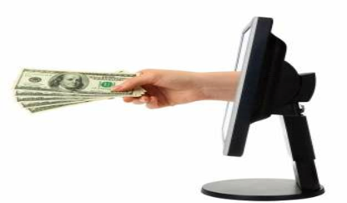
Electronic Payment Systems
(EPS)
Presented by :Sonam Bhatia
Dept :Computer Science

Slide 2
Agenda
What is Electronic Payment Systems
Phases in Electronic Payment
Prons & Cons of Using E-Payment System
Types of electronic payments
How to Select best EPS

Slide 3
Electronic Payment Systems (EPS)
EPSs enable a customer to pay for the goods and services online by using integrated hardware and software systems.
An electronic payment is defined as a payment services that utilize ICT, including cryptography and telecommunications networks EPS increase efficiency, improve security, enhance customer convenience and ease of use.
Some Examples Of EPS:-
Online Reservation
Online Bill Payment
Online Order Placing
Online Ticket Booking

Slide 4
E-Payment Phases
Registration: This phase involves the registration of the payer and the payee with the issuer and acquirer respectively. Most electronic payments designed require registration of payers and payees with their corresponding banks so there is a link between their identities and their accounts held at the bank.
Invoicing: In this phase, the payee obtains an invoice for payment from the payee. This is accomplished by either browsing and selecting products for purchase from the merchant’s (payee’s) website in case of purchases made through the internet or obtaining an electronic invoice using other electronic communication medium like e-mail.

Slide 5
Epayment Phases
Payment selection and processing: In this phase the payer selects type of payment, (card based, e-cash, e-cheque, etc.,) based on the type of payment the payee accepts. Based on the selection, the payer then sends the relevant payment details like account number, unique identifiers of the payer to the payee along with accepted amount based on the invoice. Certain protocols might also require the payer to obtain preauthorised token (like bank drafts) from the issuer before the payer sending the payment information to the payee.
Payment authorisation and confirmation: In this phase, the acquirer on receiving payment details from the payee authorises the payment and issues a receipt containing the success or failure of the payment to the payee. The payee based on the message may also issue a receipt of payment to the payer.

Slide 6
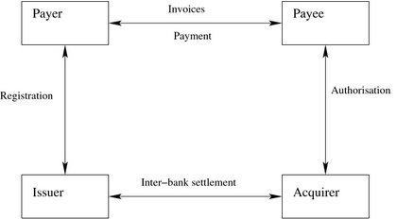
Epayment Phases

Slide 7
Pros and cons of using an e-payment system
Reaching more clients from all over the world, which results in more sales.
More effective and efficient transactions — It’s because transactions are made in seconds , without wasting customer’s time. It comes with speed and simplicity.
Convenience. Customers can pay for items on an e-commerce website at anytime and anywhere. They just need an internet connected device. As simple as that!
Lower transaction cost and decreased technology costs.

Slide 8
Expenses control for customers, as they can always check their virtual account where they can find the transaction history.
Today it’s easy to add payments to a website, so even a non-technical person may implement it in minutes and start processing online payments.
Payment gateways and payment providers offer highly effective security and anti-fraud tools to make transactions reliable.

Slide 9
Drawbacks
Sounds great, so are there any drawbacks?
E-commerce fraud is growing at 30% per year. If you follow the security rules, there shouldn’t be such problems, but when a merchant chooses a payment system which is not highly secure, there is a risk of sensitive data breach which may cause identity theft.
The lack of anonymity — For most, it’s not a problem at all, but you need to remember that some of your personal data is stored in the database of the payment system.
The need for internet access — As you may guess, if the internet connection fails, it’s impossible to complete a transaction, get to your online account, etc.
Sounds great, so are there any drawbacks?
E-commerce fraud is growing at 30% per year. If you follow the security rules, there shouldn’t be such problems, but when a merchant chooses a payment system which is not highly secure, there is a risk of sensitive data breach which may cause identity theft.
The lack of anonymity — For most, it’s not a problem at all, but you need to remember that some of your personal data is stored in the database of the payment system.
The need for internet access — As you may guess, if the internet connection fails, it’s impossible to complete a transaction, get to your online account, etc.

Slide 10
Types of electronic payments
Electronic
Funds Transfer
(EFT)
Payment
Cards
Electronic
Cash Systems
Electronic
Check (E-
check)
Electronic
wallets
Micro Payment
Systems

Slide 11
Payment Cards
 Electronic card payments continue to have a
meaningful impact on the world.
 Most of consumers use credit cards to pay for online
purchases.
 Card transaction volume grew at an annual growth
More than 85% of worldwide consumer Internet
purchases are paid for with credit cards.
▪ Credit Cards
▪ Debit Cards
▪ Web Cards
▪ Charge Cards

Slide 12
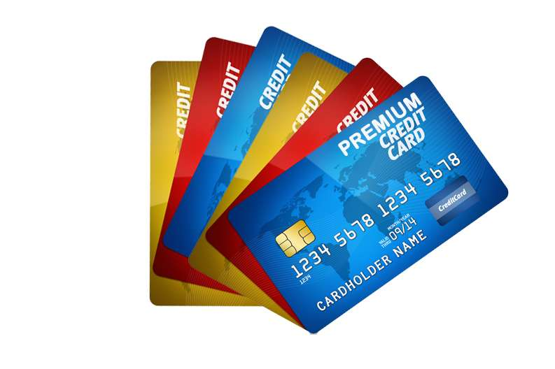
Credit Card
Payment using credit card is one of most common mode of electronic payment. Credit card is small plastic card with a unique number attached with an account. It has also a magnetic strip embedded in it which is used to read credit card via card readers. When a customer purchases a product via credit card, credit card issuer bank pays on behalf of the customer and customer has a certain time period after which he/she can pay the credit card bill. It is usually credit card monthly payment cycle. Following are the actors in the credit card system.
The card holder − Customer
The merchant − seller of product who can accept credit card payments.
The card issuer bank − card holder's bank
The acquirer bank − the merchant's bank

Slide 13
Credit Card
Credit Card Payment Process:
Bank issues and activates a credit card to the customer on his/her request.
The customer presents the credit card information to the merchant site or to the merchant from whom he/she wants to purchase a product/service.
Merchant validates the customer's identity by asking for approval from the card brand company.
Card brand company authenticates the credit card and pays the transaction by credit. Merchant keeps the sales slip.
Merchant submits the sales slip to acquirer banks and gets the service charges paid to him/her.

Slide 14
Credit Card
Acquirer bank requests the card brand company to clear the credit amount and gets the payment.
Now the card brand company asks to clear the amount from the issuer bank and the amount gets transferred to the card brand company.

Slide 15
Debit Card
Debit card, like credit card, is a small plastic card with a unique number mapped with the bank account number.
It is required to have a bank account before getting a debit card from the bank.
The major difference between a debit card and a credit card is that in case of payment through debit card, the amount gets deducted from the card's bank account immediately and there should be sufficient balance in the bank account for the transaction to get completed; whereas in case of a credit card transaction, there is no such compulsion.
Debit cards free the customer to carry cash and cheques. Even merchants accept a debit card readily. Having a restriction on the amount that can be withdrawn in a day using a debit card helps the customer to keep a check on his/her spending.

Slide 16
Electronic Cash Systems
 A system that allows a person to pay for goods or services by transmitting a number from one computer to another.Like the serial numbers on real currency notes, the E-cash numbers are unique.This is issued by a bank and represents a specified sum of real money.It is anonymous and reusable.
Electronic Cash Security:Complex cryptographic algorithms prevent double spending.
Anonymity is preserved unless double spending is attempted.Serial numbers can allow tracing to prevent money laundering .

Slide 17
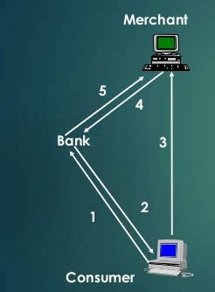
Electronic Cash Systems
 E-Cash Processing
Consumer buys e-cash from Bank
Bank sends e-cash bits to consumer (after charging that amount plus fee)
Consumer sends e-cash to merchant
Merchant checks with Bank that e-cash is valid (check for forgery or fraud)
Bank verifies that e-cash is valid
Parties complete transaction

Slide 18
How to Select best One
 Is it Security ?
 Is it Reliable?
 Is it Easy to Use?

Slide 19
Thank You

